Slide 1

DAVI CA2
Would Greater Use of Electric Cars Be More Beneficial In Singapore?
Admin No: p2122924
Name: Ryan Ueda Teo Shao Ming

Slide 2
DATASETS
Dataset 1: Annual Motor Vehicle Population By Type Of Fuel Used (2006-2018)
Link: https://data.gov.sg/dataset/annual-motor-vehicle-population-by-type-of-fuel-used
Dataset 2: Average Public Transport Ridership (1995-2016)
Link: https://data.gov.sg/dataset/public-transport-utilisation-average-public-transport-ridership
Dataset 3: Causes Of Road Accidents by Severity Of Injury Sustained (2012-2018)
Link: https://data.gov.sg/dataset/causes-of-road-accidents-causes-of-accidents-by-severity-of-injury-sustained
Dataset 4: SG/HK Annual CO2 Emissions (1938-2020)
Link: https://ourworldindata.org/co2/country/singapore
Dataset 5: SG/HK Cumulative CO2 Emissions (1938-2020)
Link: https://ourworldindata.org/co2/country/singapore
Dataset 6: Survey Done For PDAS/DAVI CA2
Dataset 7: SG Renewable Electricity Generating Capacity from 2000-2019
Link: https://ourworldindata.org/grapher/renewable-electricity-generating-capacity-per-capita?tab=chart&country=~SGP
Dataset 8: CO2 Emissions By Mode Of Transport (2018)
Link: https://ourworldindata.org/grapher/co2-transport-mode

Slide 3
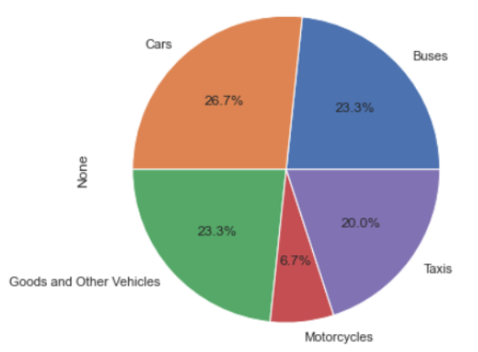
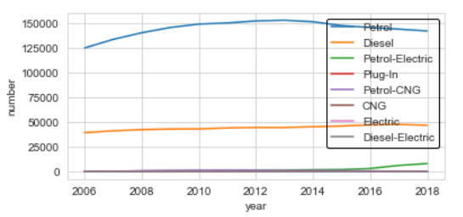
Objective 1:
Would Use Of Electric Motor Vehicles Be More Environmentally Friendly?
- The pie chart on the right shows the proportion of type of vehicle from 2006-2018
- Cars take up the largest percentage, while motorcycles take up the least
- The percentage of Cars, Buses, Taxis and Goods & Other Vehicles are very similar, with Buses and Goods & Other Vehicles being exactly the same
- The line graph shows the trend of number of vehicles by type of fuel used
- There has been a negligible amount of change in proportion and number of vehicles across the years
- Although Petrol-Electric hybrid vehicles has seen an increase recently, other forms of electric vehicles are still low, close to 0

Slide 4
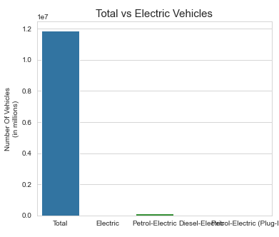
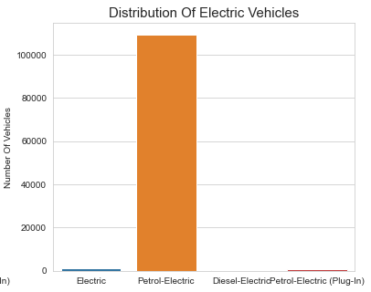
Objective 1:
Would Use Of Electric Motor Vehicles Be More Environmentally Friendly?
- The first bar chart shows the total number as compared to the types of electric cars in Singapore
- As compared to the total, the types of electric cars are close to not being able to be seen
- The second bar chart shows the distribution of number of vehicles among the electric car types
- Petrol-Electric hybrid cars are significantly higher than the others, at above 10,000 vehicles
- It is clear that purely Electric cars have a very small presence in Singapore with close to 0

Slide 5
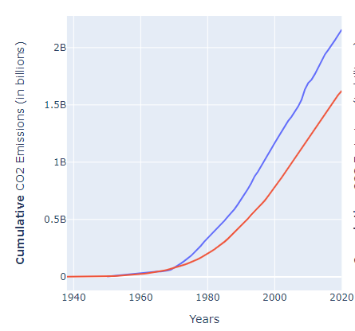
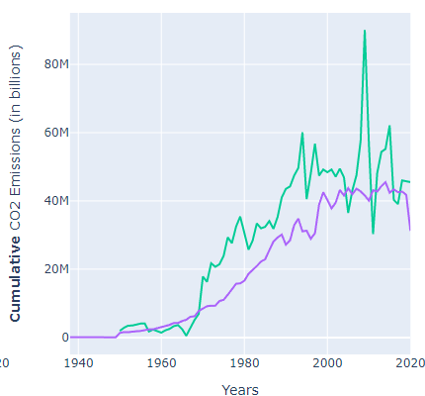
Objective 1:
Would Use Of Electric Motor Vehicles Be More Environmentally Friendly?
- The first line chart shows Singapore and Hong Kong’s cumulative CO2 emissions
- Both lines take an exponential form, however Hong Kong has produced much lesser CO2 emissions, and is increasing more slowly as compared to Singapore
- The second line chart shows Singapore and Hong Kong’s annual CO2 emissions
- Although both countries have a relatively similar shape, Singapore’s annual CO2 emissions are much more volatile as seen in the years nearing 2020
- In 2020, Hong Kong has seen a sudden dip in CO2 emissions, while Singapore’s is starting to rise once again

Slide 6
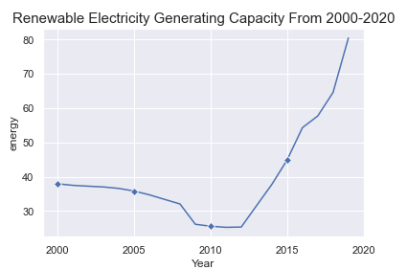
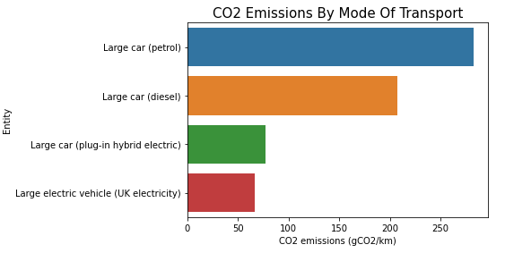
Objective 1:
Would Use Of Electric Motor Vehicles Be More Environmentally Friendly?
- From the line graph, it is shown that Singapore’s renewable electricity generating capacity has been increasing significantly in recent years
- It is very likely that Singapore’s renewable electricity generating capacity will continue to increase rapidly in the upcoming years
- The bar graph shows that petrol and diesel cars has a much larger carbon footprint as compared to hybrid and pure electric vehicles
- Compared to petrol vehicles, electric vehicles produce close to 5 times lesser CO2 per kilometre travelled, which is a very steep ratio

Slide 7
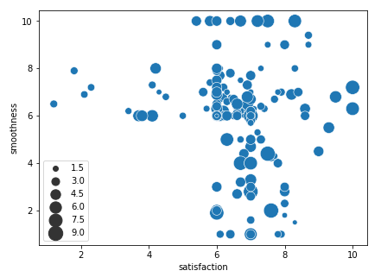
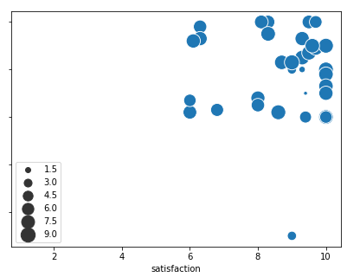
Objective 1:
Would Use Of Electric Motor Vehicles Be More Environmentally Friendly?
- The first bubble plot shows the scatter of satisfaction, smoothness and noise level of their most recent petrol bus ride
- Responses are largely clustered in the center, with quite a few outliers
- The second bubble plot shows the scatter of satisfaction, smoothness and noise level of their most recent electric bus ride
- Most responses are clustered in the upper right corner, with a single outlier at the bottom left
- It is clear that people have much better experiences riding in electric buses as compared to petrol buses
reference: https://www.straitstimes.com/singapore/dip-in-those-who-were-satisfied-with-public-transport-but-most-feel-improvement-from

Slide 8
Complications
- Despite Electric vehicles being seemingly more eco-friendly as compared to cars that run on fossil fuels, the source of electricity is also a factor
- Electric cars use lithium-ion batteries, which use raw materials such as cobalt, lithium and other rare metals which are known to have grave consequences on the environment. Especially cobalt, which has raised controversial talks on environmental and human rights concerns many times
- Unless electricity generated if from safe or renewable sources, electric cars may not be as environmentally beneficial as it seems
reference: https://youmatter.world/en/are-electric-cars-eco-friendly-and-zero-emission-vehicles-26440/
https://www.nytimes.com/2021/03/02/climate/electric-vehicles-environment.html

Slide 9
Suggestions
1) Singapore should spread more awareness on the current situation of Electric Cars in Singapore, and promote the usage of electric vehicles more, along with their benefits. This could come in the form of a first-time buyer financial scheme or lower parking fares
2) Singapore should bring in more electric buses, as it is superior as compared to petrol buses in many aspects. Passengers find electric vehicles to be a more comfortable experience overall, and also find it safer than petrol vehicles
3) Singapore should place greater emphasis in bettering the country’s renewable electricity generating capacity to make the usage of electric vehicles more common as soon as possible

Slide 10
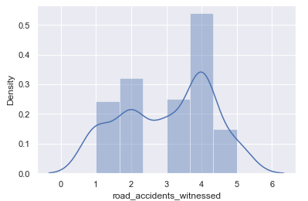
Objective 2:
Would Use Of Electric Motor Vehicles Reduce Number Of Road Accidents?
- The histogram shows the frequency of road accidents witnessed per month
- As shown in the graph, the number of people who witness 4 accidents per month is extremely high, nearly twice the number of the second highest
- 4 accidents a month are around 1 accident per week, which is alarmingly high
- Not a single person has seen 0 accidents per month
- Road accidents in Singapore are too high

Slide 11
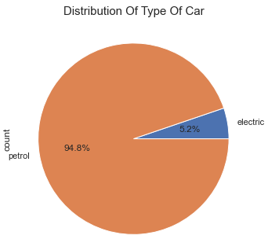
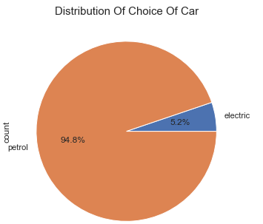
Objective 2:
Would Use Of Electric Motor Vehicles Reduce Number Of Road Accidents?
- The first pie chart shows the distribution of type of car that people own
- The second pie chart shows that the distribution of people’s ideal choice of car
- Both pie charts have the exact same percentage of petrol and electric cars
- This concludes that there are no external factors that affect peoples choice on what type of car they would purchase

Slide 12
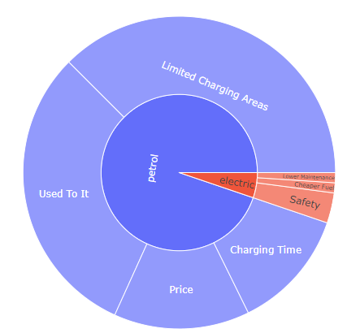
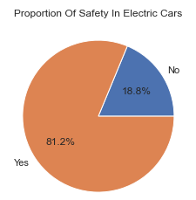
Objective 2:
Would Use Of Electric Motor Vehicles Reduce Number Of Road Accidents?
- The pie chart shows the proportion of choice of cars and reasons for the choice
- The most common reasons for choosing petrol over electric cars are ‘Limited Charging Areas’ and ‘Used To It’, with ‘Price’ and ‘Charging Time’ taking up the remainder
- Reasons why people chose electric over petrol cars include ‘Lower Maintenance’, ‘Cheaper Fuel’, and the most common reason being ‘Safety’
- Majority of people, over 80% feel more safe in electric vehicles as compared to petrol vehicles
reference: https://www.straitstimes.com/singapore/transport/620-electric-vehicle-chargers-to-be-installed-at-public-carparks-in-the-next-12
https://www.cnbc.com/2021/12/29/electric-vehicles-are-becoming-more-affordable-amid-spiking-gas-prices.html https://www.budgetdirect.com.sg/car-insurance/research/public-transport-singapore#:~:text=Forty%20per%20cent%20of%20Singapore's,rail%20lines%20are%20being%20built.&text=Average%20daily%20ridership%20on%20the,rides%20a%20day%20in%202019.
https://www.drivingelectric.com/your-questions-answered/314/is-an-electric-car-safe-in-a-crash

Slide 13
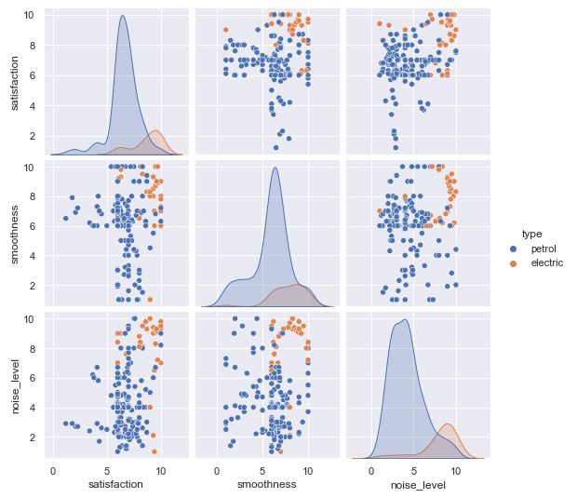
Objective 2:
Would Use Of Electric Motor Vehicles Reduce Number Of Road Accidents?
- The pairplot shows various graphs on satisfaction, smoothness and noise level
- As shown in the graph, electric cars have far better responses in all categories
- The spread and variance of petrol responses are extremely spread out with highly differing experiences
- electric responses are all clustered together, showing that it is always consistent in experience

Slide 14
Complications
- Although Electric cars are known to be safer than petrol cars in terms of combustion, everyday usage, self-driving and danger prevention, wwe cannot entirely rule out the probability of it malfunctioning like petrol cars in the future
- Although electric cars will very likely combat the current road accidents in Singapore and make it safer, a very large amount of road accidents are a result of Singaporeans negligence of road etiquette
- Alternatively, greater law enforcement and education on road safety could be another wwawy of combatting this issue

Slide 15
Suggestions
1) Singapore should encourage the use of electric vehicles more as they are safer than petrol cars
2) Singapore should impose stricter laws on car ownership, as the current rate of road accidents are too high
3) Singapore should impose new schemes to introduce more people to electric vehicles, and persuade them into owning one as compared to petrol vehicles

